Slide 1
Secure Instant Point to Point Messaging
Mounica Gandlaparthi
Swetha pasham
Prakruthi Shivram

Slide 2
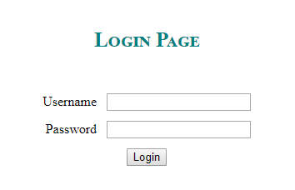
Login
Username
Password
Session created

Slide 3
Apache Active MQ
Open source message broker
Provides Enterprise features
Reliable communication between two distributed processes
As soon as the message is received it is deleted

Slide 4
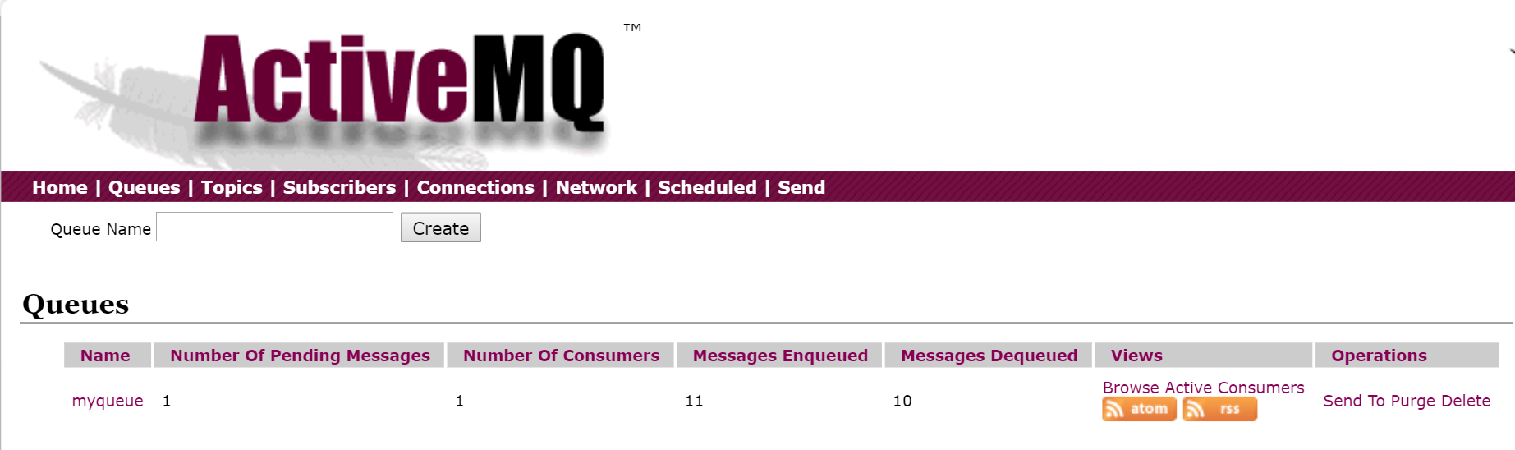
Apache active mq – my queue

Slide 5
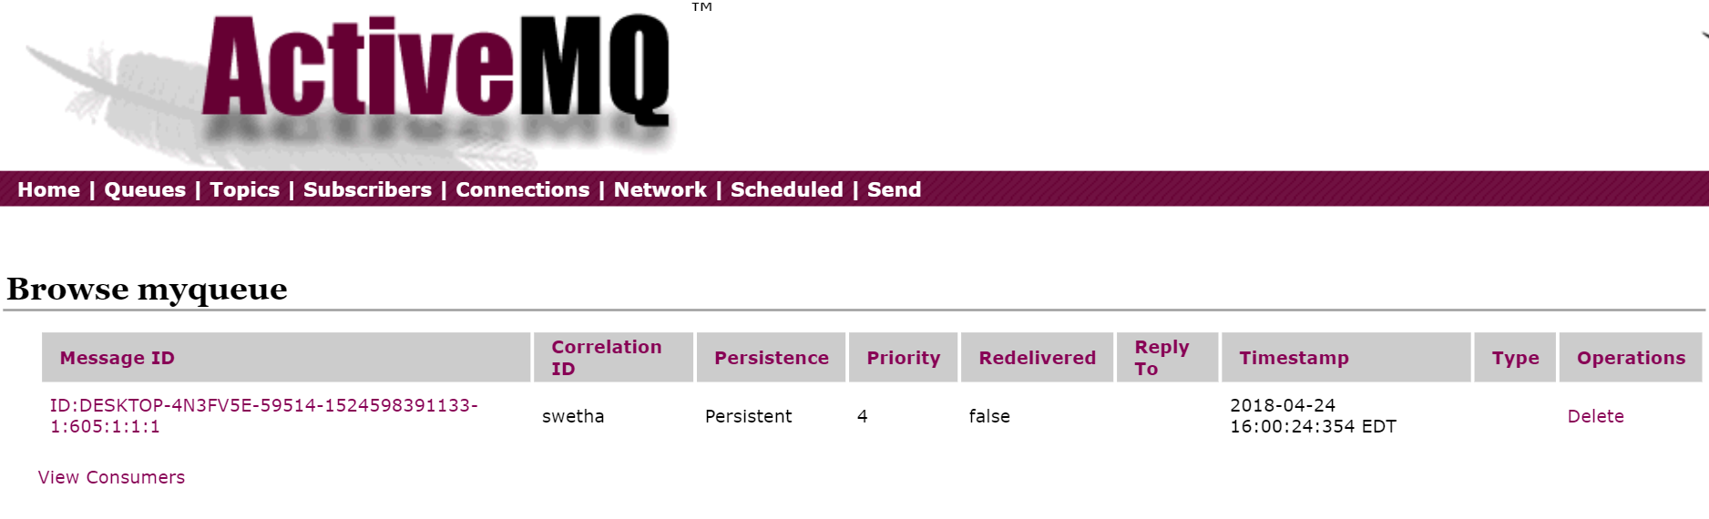
Pending messages

Slide 6
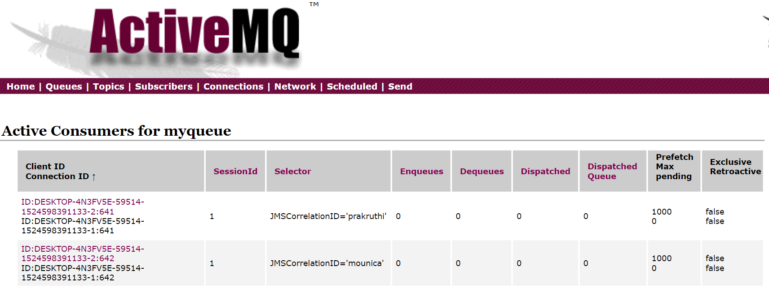
Active clients

Slide 7
Message broker
Program module that translates message from the formal messaging protocol of the sender to the formal messaging protocol of the receiver.
Examples of actions that might be taken in by the broker
Route messages to one or more destinations
Interact with an external repository to augment a message or store it.
Invoke web services to retrieve data

Slide 8
JMS API
Java Message Oriented Middleware API for sending messages between two or more clients
JMS API supports point to point model
It provides loosely coupled, reliable and asynchronous communication.

Slide 9
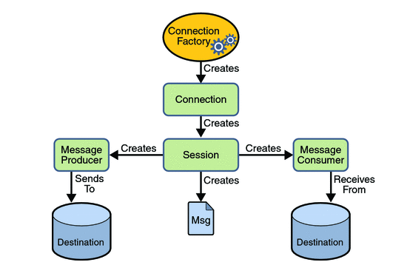
JMS Programming model

Slide 10
Send Message
Get user name
Start session
Encrypt message with DES
Send message using JMS API

Slide 11
Des Encryption
PBEParameterSpec object encapsulates the salt and iteration count
PBEKeySpec object encapsulates the password
Get the SecretKeyFactory instance using DES algorithm.
Generate SecureKey (PBEKeySpec) that will be used for encryption and decryption.
Get Cipher instance using DES algorithm, one for encrypt mode and another for decrypt mode.
Initialize the cypher object with mode, secret key and paramspec.

Slide 12
Encryption and decryption
Create a Cipher object for encrypt mode
Message string to UTF-8 encoding bytes
doFinal( ) – encrypts data
Encodebase64
Create a cipher object for decrypt mode
Decodebase64
doFinal() – decrypts data
UTF-8 to String

Slide 13
Check incoming message
Get username
Get session
Receive message using JMS API
Decrypt message with DES
Add to the message list

Slide 14
